Slide 1

Laura Kalambokidis
One Minnesota Conference
January 7, 2015
Minneapolis, MN
Economic Outlook Across Minnesota
MINNESOTA MANAGEMENT & BUDGET
MMB.STATE.MN.US

Slide 2
Minnesota’s diverse industry profile mirrors U.S.
Percent of Total Non-Farm Employment by Sector (2013)
Source: MN Department of Employment and Economic Development (DEED)

Slide 3
Regional center unemployment rates falling

Slide 4
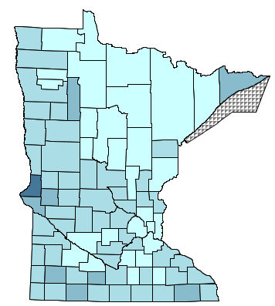
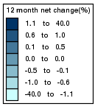
County unemployment rates falling
12-month change in unemployment rates by county,
not seasonally adjusted, November 2014
(Source: U.S. Bureau of Labor Statistics)

Slide 5
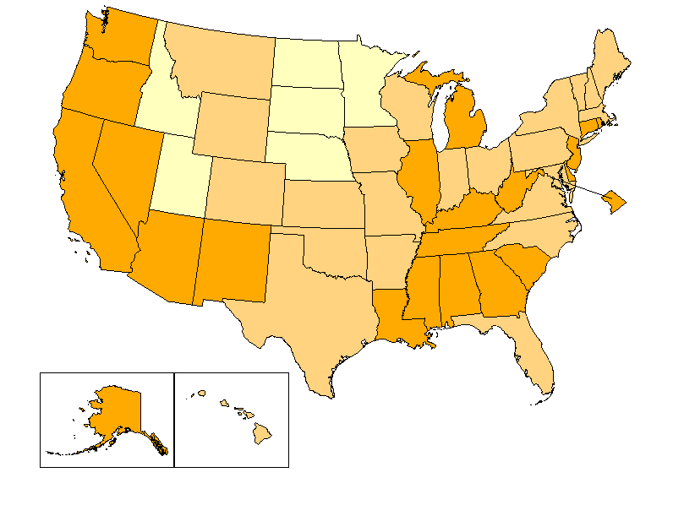
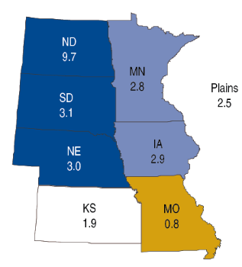

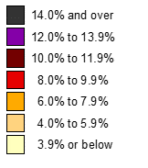
Low unemployment, high growth region
Unemployment rates by state,
seasonally adjusted, November 2014
(Source: U.S. Bureau of Labor Statistics)
Percent change in real GDP by state,
plains region, 2013
(Source: Bureau of Economic Analysis)

Slide 6
Industry profile, labor market influence Minnesota economy
Industrial diversity helps economic resilience
Perfect storm tightens state labor market
  Economic expansion
  Slower labor force growth
  Low unemployment neighborhood
To thrive: attract, train, retain workers

